Slide 1
Self Driven Car COA Lab Project(2016-17) THE LNMIIT, Jaipur
Anjali Gupta 15UCC003
Chhaya Hotwani 15UCC012
Jiten Singh Sadhwani 15UCC017
Prabhat Kumar Tripathi 15UCC023

Slide 2
Introduction
An autonomous car (driverless car, self-driving car, robotic car[) is a vehicle that is capable of sensing its environment and navigating without human input.
Autonomous cars have control systems that are capable of analyzing sensory data to distinguish between different cars on the road, which is very useful in planning a path to the desired destination.

Slide 3
Functions
Speed Control – Increase and decrease the speed according to the path.
Wheel Direction Control- Change the direction of the wheel according to the angle.
Gear Control – On changing speed gear changes.
Obstacle Check – Blows horn and pause for sometime whenever encounter any obstacle.
Fuel Check – Check remaining fuel.

Slide 4
Functions
Predicting Time Left – Time left for the car to cover the given distance.
Light Control – ON and OFF of the light according to day and night.
Indicator – Gives indicator according to direction (Turns).
Members Check – Checks the capacity of the car.
Automatic AC- Compares the temperature of the car with the outside temperature and switch on the AC.

Slide 5
Memory Model
16 Bits Instructions
Little Endian
Byte Addressable Memory
Aligned Memory Model

Slide 6
Registers
12 General Purpose Registers which are used for storing values of temporary variables or memory addresses.
From R00 to R11.
The FR has following condition code bits which are set when the result is:
N – Negative
Z - zero
3 Special Purpose Registers
PC – Program Counter
IR – Instruction Register
FR – Flag Register

Slide 7
Instruction Format
Opcode | Register | Register
8 bit | 4 bit | 4 bit
Two address Instruction
Instruction Format | Description
MOV R1,R2 00000000 0001 0010 | Copies content of R2 into R1
CMP R1,R2 00000001 0001 0010 | Compares value of R1 and R2
ADD R1,R2 00000010 0001 0010 | Add contents of R1 ,R2 and store in R1
SUB R1,R2 00000011 0001 0010 | Subtract contents of R1 ,R2 and store in R1
MUL R1,R2 00000100 0001 0010 | Multiply contents of R1 ,R2 and store in R1
DIV R1,R2 00000101 0001 0010 | Divison contents of R1 ,R2 and store in R1
LDB @R1,R2 00000110 0001 0010 | Load value at memory address stored in R1 into R2
STB @R1,R2 00000111 0001 0010 | Store value in R2 at memory address of R1

Slide 8
Opcode | Value | Register
8 bit | 4 bit | 4 bit
Instruction Format | Description
MOV1 R01,#value 00010000 0001 #### | This can be used to move constant values in registers
CMP1 R01,#value 00010001 0001 #### | Compare a constant value with a value stored in R1
ADD1 R01,#value 00010010 0001 #### | Adds a constant value with a value stored in R1
SUB1 R01,#value 00010011 0001 #### | Subtracts a constant value with a value stored in R1

Slide 9
One address Instruction
Instruction Format | Description
JMP $L0 00001011 00000000 | Jump unconditionally to memory address
JEQ $L0 00001100 00000000 | Jump if equal
JNE $L0 00001101 00000000 | Jump if not equal
JLT $L0 00001110 00000000 | Jump if less than
JGTE $L0 00001111 00000000 | Jump if greater than equal to
Opcode | Address/Value
8 bits | 8 bits

Slide 10
Zero address Instruction
Opcode
16 bits
Instruction Format | Description
HLT 1111111111111111 | Halt the program

Slide 11
Instruction Design
Reduced Instruction Set Computer (RISC) is used as it can be implemented easily as they are simple instructions and can be executed in one clock cycle.
Fixed length instructions : Which are easy to decode. Length of each instruction is one word i.e. 16 bits.

Slide 12
INSTRUCTION TYPES
Data Transfer –
Register to Register : MOV1
Memory to Register : LDB
Register to Memory : STB
Constant into Register : MOV2
Dyadic –
MOV , ADD , SUBT , MUL ,DIV , CMP ,ADD , OR
Comparison and Conditional branching –
JMP , JNQ , JEQ ,JNZ ,JGT ,JLT , CMP

Slide 13
Data Types
Numeric –
Integer (Signed and unsigned).
Non-numeric –
String, Boolean .

Slide 14
Addressing Modes
Immediate Addressing Mode –
Register Addressing Mode –
Register Indirect Mode –
Opcode | Immediate | Register
MOV | #4 | R00
Opcode | Register | Register
MOV | R00 | R01
Opcode | Register | Register
LDB | R1 | @R2

Slide 15
FLOW OF CONTROL HANDLING
Branch <function name> :-
Jumps to specified function.
Pause(Special Register) :- Stop the car i.e. resets the values.

Slide 16
Datapath
Single Bus Architecture
A Datapath is a collection of functional units, such as arithmetic logic units or multipliers, that perform data processing operations, registers, and buses. Along with the control unit it composes the Central Processing Unit(CPU).

Slide 17
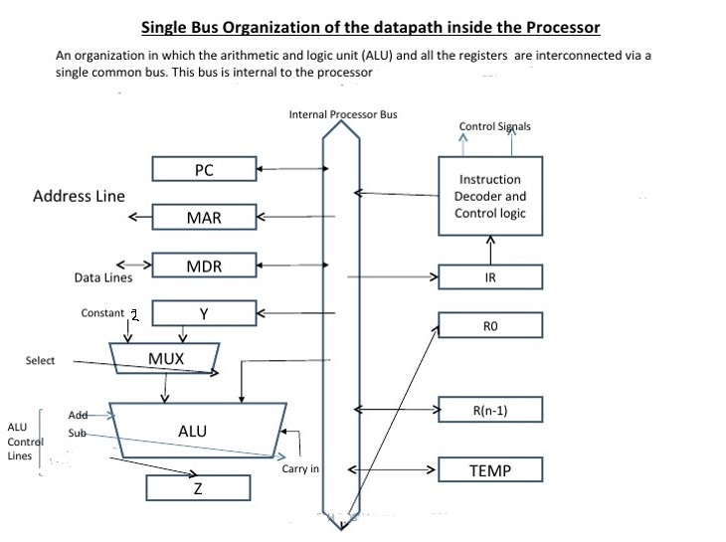
Diagram of Datapath

Slide 18
ARITHMETIC LOGIC UNIT
An arithmetic logic unit (ALU) is a digital circuit used to perform arithmetic and logic operations. It represents the fundamental building block of the central processing unit (CPU) of a computer.

Slide 19
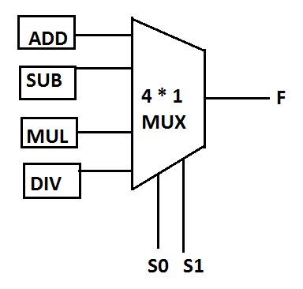
Operation | S0 | S1
Add | 0 | 0
Subtract | 0 | 1
Multiply | 1 | 0
Division | 1 | 1

Slide 20
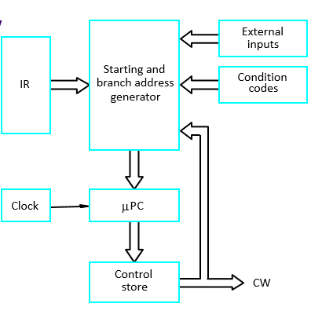
CONTROL UNIT for MICROPROGRAMMED CONTROLLED
(For Flag Checking)

Slide 21
MicroInstructions
FETCH CYCLE
1. PCout , MARin ,Read , Select 2 , ADD , Zin
2. WMFC , Zout, Yin, PCin
3. MDRin-ext , MDRout , IRin
4. Branching to appropriate microroutine.

Slide 22
MicroInstruction | PCin | PCout | MARin | MARout | MDRin-ext | READ | WMFC | Yin | Zin | IRin | MDRout | ADD | SELECT 2 | Zout
1.) | 0 | 1 | 1 | 0 | 0 | 1 | 0 | 0 | 1 | 0 | 0 | 1 | 1 | 0
2.) | 1 | 0 | 0 | 0 | 0 | 0 | 1 | 1 | 0 | 0 | 0 | 0 | 0 | 1
3.) | 0 | 0 | 0 | 0 | 1 | 0 | 0 | 0 | 0 | 1 | 1 | 0 | 0 | 0

Slide 23
ADD R1,R2
Fetch Cycle
R1out, Yin , select Y, Yout
R2out, ADD , Zin
Zout, R1in ,END

Slide 24
MicroInstruction | R1out | R2out | R1in | R2in | Yin | Yout | SELECT Y | READ | WRITE | ADD | Zin | Zout | END
1.) | 1 | 0 | 0 | 0 | 1 | 1 | 1 | 0 | 0 | 0 | 0 | 0 | 0
2.) | 0 | 1 | 0 | 0 | 0 | 0 | 0 | 0 | 0 | 1 | 1 | 0 | 0
3.) | 0 | 0 | 1 | 0 | 0 | 0 | 0 | 0 | 0 | 0 | 0 | 1 | 1

Slide 25
SUB R1,R2
Fetch Cycle
R1out, Yin , select Y, Yout
R2out, SUB , Zin
Zout, R1in ,END

Slide 26
MicroInstruction | R1out | R2out | R1in | R2in | Yin | Yout | SELECT Y | READ | WRITE | SUB | Zin | Zout | END
1.) | 1 | 0 | 0 | 0 | 1 | 1 | 1 | 0 | 0 | 0 | 0 | 0 | 0
2.) | 0 | 1 | 0 | 0 | 0 | 0 | 0 | 0 | 0 | 1 | 1 | 0 | 0
3.) | 0 | 0 | 1 | 0 | 0 | 0 | 0 | 0 | 0 | 0 | 0 | 1 | 1
MicroInstruction | R1out | R2out | R1in | R2in | Yin | Yout | SELECT Y | SUB | Zin | Zout | END
1.) | 1 | 0 | 0 | 0 | 1 | 1 | 1 | 0 | 0 | 0 | 0
2.) | 0 | 1 | 0 | 0 | 0 | 0 | 0 | 1 | 1 | 0 | 0
3.) | 0 | 0 | 1 | 0 | 0 | 0 | 0 | 0 | 0 | 1 | 1

Slide 27
MUL R1,R2
Fetch Cycle
R1out, Yin , select Y, Yout
R2out, MUL , Zin
Zout, R1in ,END

Slide 28
MicroInstruction | R1out | R2out | R1in | R2in | Yin | Yout | SELECT Y | READ | WRITE | MUL | Zin | Zout | END
1.) | 1 | 0 | 0 | 0 | 1 | 1 | 1 | 0 | 0 | 0 | 0 | 0 | 0
2.) | 0 | 1 | 0 | 0 | 0 | 0 | 0 | 0 | 0 | 1 | 1 | 0 | 0
3.) | 0 | 0 | 1 | 0 | 0 | 0 | 0 | 0 | 0 | 0 | 0 | 1 | 1
MicroInstruction | R1out | R2out | R1in | R2in | Yin | Yout | SELECT Y | MUL | Zin | Zout | END
1.) | 1 | 0 | 0 | 0 | 1 | 1 | 1 | 0 | 0 | 0 | 0
2.) | 0 | 1 | 0 | 0 | 0 | 0 | 0 | 1 | 1 | 0 | 0
3.) | 0 | 0 | 1 | 0 | 0 | 0 | 0 | 0 | 0 | 1 | 1

Slide 29
DIV R1,R2
Fetch Cycle
R1out, Yin , select Y, Yout
R2out , DIV , Zin
Zout, R1in ,END

Slide 30
MicroInstruction | R1out | R2out | R1in | R2in | Yin | Yout | SELECT Y | READ | WRITE | DIV | Zin | Zout | END
1.) | 1 | 0 | 0 | 0 | 1 | 1 | 1 | 0 | 0 | 0 | 0 | 0 | 0
2.) | 0 | 1 | 0 | 0 | 0 | 0 | 0 | 0 | 0 | 1 | 1 | 0 | 0
3.) | 0 | 0 | 1 | 0 | 0 | 0 | 0 | 0 | 0 | 0 | 0 | 1 | 1
MicroInstruction | R1out | R2out | R1in | R2in | Yin | Yout | SELECT Y | DIV | Zin | Zout | END
1.) | 1 | 0 | 0 | 0 | 1 | 1 | 1 | 0 | 0 | 0 | 0
2.) | 0 | 1 | 0 | 0 | 0 | 0 | 0 | 1 | 1 | 0 | 0
3.) | 0 | 0 | 1 | 0 | 0 | 0 | 0 | 0 | 0 | 1 | 1

Slide 31
CMP R1 R2
Fetch Cycle
R1out, Yin , select Y, Yout
R2out, SUB, Zin
If Z<0 then N = 1 , END
If Z=0 then Zero flag= 1 , END
END

Slide 32
According to condition flag will be set and signal for END is generated
MicroInstruction | R1out | R2out | R1in | R2in | Yin | Yout | SELECT Y | READ | WRITE | SUB | Zin | Zout | END
1.) | 1 | 0 | 0 | 0 | 1 | 1 | 1 | 0 | 0 | 0 | 0 | 0 | 0
2.) | 0 | 1 | 0 | 0 | 0 | 0 | 0 | 0 | 0 | 1 | 1 | 0 | 0
3.) | 0 | 0 | 0 | 0 | 0 | 0 | 0 | 0 | 0 | 0 | 0 | 0 | 1

Slide 33
LOAD R1, @R2
Fetch Cycle
R2out,MARin,MARout-ext,READ,WMFC,MDRin-ext
MDRout,R1in, END

Slide 34
MicroInstruction | R1out | R2out | R1in | R2in | MARin | MDRin-ext | READ | WMFC | MARout-ext | MDRout | END
1.) | 0 | 1 | 0 | 0 | 1 | 1 | 1 | 1 | 1 | 0 | 0
2.) | 0 | 0 | 1 | 0 | 0 | 0 | 0 | 0 | 0 | 1 | 1

Slide 35
STORE R1, @R2
Fetch Cycle
R2out,MARin,MARout-ext
R1out,MDRin,MDRout-ext, WRITE,WMFC
END

Slide 36
MicroInstruction | R1out | R2out | MDRin | MARin | MDRout-ext | MARout-ext | READ | WRITE | WMFC | MDRout | END
1.) | 0 | 1 | 0 | 1 | 0 | 1 | 0 | 0 | 0 | 0 | 0
2.) | 1 | 0 | 1 | 0 | 1 | 0 | 0 | 1 | 1 | 0 | 0
3.) | 0 | 0 | 0 | 0 | 0 | 0 | 0 | 0 | 0 | 1 | 1

Slide 37
JMP L1
Instruction Fetch
IRout , OFFSETFIELDout, select Y, ADD, Zin
Zout, PCin ,Yin, END

Slide 38
MicroInstruction | IRout | SELECT Y | ADD | Zin | Zout | PCin | Yin | OFFSET out | END
1.) | 1 | 1 | 1 | 1 | 0 | 0 | 0 | 1 | 0
2.) | 0 | 0 | 0 | 0 | 1 | 1 | 1 | 0 | 1

Slide 39
JNQ L1
Instruction Fetch
IRout , OFFSETFIELDout, select Y, ADD, Zin
If Zero flag(Z)=1 then END
Zout, PCin ,Yin, END

Slide 40
If Zero flag = 1
MicroInstruction | IRout | SELECT Y | ADD | Zin | Zout | PCin | Yin | OFFSET out | END
1.) | 1 | 1 | 1 | 1 | 0 | 0 | 0 | 1 | 0
2.) | 0 | 0 | 0 | 0 | 0 | 0 | 0 | 0 | 1
3.) | 0 | 0 | 0 | 0 | 1 | 1 | 1 | 0 | 1

Slide 41
JEQ L1
Instruction Fetch
IRout , OFFSETFIELDout, select Y, ADD, Zin
If Zero flag (Z)=0 then END
Zout, PCin ,Yin, END

Slide 42
If Zero flag = 0
MicroInstruction | IRout | SELECT Y | ADD | Zin | Zout | PCin | Yin | OFFSET out | END
1.) | 1 | 1 | 1 | 1 | 0 | 0 | 0 | 1 | 0
2.) | 0 | 0 | 0 | 0 | 0 | 0 | 0 | 0 | 1
3.) | 0 | 0 | 0 | 0 | 1 | 1 | 1 | 0 | 1

Slide 43
JLT L1
Instruction Fetch
IRout , OFFSETFIELDout, select Y, ADD , Zin
If N=0 then END
Zout , PCin, Yin, END

Slide 44
If N = 0
MicroInstruction | IRout | SELECT Y | ADD | Zin | Zout | PCin | Yin | OFFSET out | END
1.) | 1 | 1 | 1 | 1 | 0 | 0 | 0 | 1 | 0
2.) | 0 | 0 | 0 | 0 | 0 | 0 | 0 | 0 | 1
3.) | 0 | 0 | 0 | 0 | 1 | 1 | 1 | 0 | 1

Slide 45
JGTE L1
Instruction Fetch
IRout , OFFSETFIELDout, select Y, ADD , Zin
If N=1 or Zero flag=0 then END
Zout , PCin, Yin, END

Slide 46
If Zero flag = 0 or N=1
MicroInstruction | IRout | SELECT Y | ADD | Zin | Zout | PCin | Yin | OFFSET out | END
1.) | 1 | 1 | 1 | 1 | 0 | 0 | 0 | 1 | 0
2.) | 0 | 0 | 0 | 0 | 0 | 0 | 0 | 0 | 1
3.) | 0 | 0 | 0 | 0 | 1 | 1 | 1 | 0 | 1

Slide 47
MOV R1 R2
PCout , MARin ,Read , select 2 , ADD , Zin
WMFC , Zout, Yin, PCin
MDRin-ext , MDRout , IRin
R1in , R2out, END

Slide 48
MicroInstruction | PCin | PCout | MARin | MARout | MDRin-ext | READ | WMFC | Yin | Zin | IRin | MDRout | ADD | SELECT 2 | Zout | R1in | R2out | END
1.) | 0 | 1 | 1 | 0 | 0 | 1 | 0 | 0 | 1 | 0 | 0 | 1 | 1 | 0 | 0 | 0 | 0
2.) | 1 | 0 | 0 | 0 | 0 | 0 | 1 | 1 | 0 | 0 | 0 | 0 | 0 | 1 | 0 | 0 | 0
3.) | 0 | 0 | 0 | 0 | 1 | 0 | 0 | 0 | 0 | 1 | 1 | 0 | 0 | 0 | 0 | 0 | 0
4.) | 0 | 0 | 0 | 0 | 0 | 0 | 0 | 0 | 0 | 0 | 0 | 0 | 0 | 0 | 1 | 1 | 1

Slide 49
ADDI R1 , value
Instruction Fetch
Immediate value of IRout,Yin,
select Y,R1out ,ADD, Zin
Zout, R1in, END
IRout | R1in | R2 in | R1out | Yin | Select Y | ADD | Zin | Zout | END
1 | 0 | 0 | 0 | 1 | 0 | 0 | 0 | 0 | 0
0 | 0 | 0 | 1 | 0 | 1 | 1 | 1 | 0 | 0
0 | 1 | 0 | 0 | 0 | 0 | 0 | 0 | 1 | 1

Slide 50
SUBI R1 , value
Instruction Fetch
Immediate value of IRout,Yin,
select Y,R1out ,SUB, Zin
Zout, R1in, END
IRout | R1in | R2 in | R1out | Yin | Select Y | SUB | Zin | Zout | END
1 | 0 | 0 | 0 | 1 | 0 | 0 | 0 | 0 | 0
0 | 0 | 0 | 1 | 0 | 1 | 1 | 1 | 0 | 0
0 | 1 | 0 | 0 | 0 | 0 | 0 | 0 | 1 | 1

Slide 51
CMPI R1, value
Instruction Fetch
Immediate value of IRout,Yin
select Y,R1out, SUB, Zin
If Z=0 then Zero flag=1, END
If Z<0 then N=1 , END
END

Slide 52
MicroInstruction | R1out | R2out | R1in | R2in | Yin | IRout | SELECT Y | SUB | Zin | Zout | END
1.) | 0 | 0 | 0 | 0 | 1 | 1 | 0 | 0 | 0 | 0 | 0
2.) | 1 | 0 | 0 | 0 | 0 | 0 | 1 | 1 | 1 | 0 | 0
3.) | 0 | 0 | 0 | 0 | 0 | 0 | 0 | 0 | 0 | 0 | 1
According to condition flag will be set and signal for END is generated

Slide 53
MOVI R1 , value
Immediate value of IRout,R2in
PCout, MARin, Read, Zin, ADD, select 2
PCin, WMFC , Yin, Zout
MDRin-ext, IRin, MDRout
R2out , R1in, END

Slide 54
MicroInstruction | PCin | PCout | IRout | R2in | MARin | MARout | MDRin-ext | READ | WMFC | Yin | Zin | IRin | MDRout | ADD | SELECT 2 | Zout | R1in | R2out | END
1.) | 0 | 0 | 1 | 1 | 0 | 0 | 0 | 0 | 0 | 0 | 0 | 0 | 0 | 0 | 0 | 0 | 0 | 0 | 0
2.) | 0 | 1 | 0 | 0 | 1 | 0 | 0 | 1 | 0 | 0 | 1 | 0 | 0 | 1 | 1 | 0 | 0 | 0 | 0
3.) | 1 | 0 | 0 | 0 | 0 | 0 | 0 | 0 | 1 | 1 | 0 | 0 | 0 | 0 | 0 | 1 | 0 | 0 | 0
4.) | 0 | 0 | 0 | 0 | 0 | 0 | 1 | 0 | 0 | 0 | 0 | 1 | 1 | 0 | 0 | 0 | 0 | 0 | 0
5.) | 0 | 0 | 0 | 0 | 0 | 0 | 0 | 0 | 0 | 0 | 0 | 0 | 0 | 0 | 0 | 0 | 1 | 1 | 1

Slide 55
The END

